Slide 1


E- Smart Web Applicatión
www.esmartstudio.in

Slide 2
Overview
Agenda of Today’s Conference
About E-Smart web application
Working of web application
Benefit of web application
Conclusion

Slide 3
Agenda
Go Digital and get Digitalization benefit
Make easy way to Photographers work
How E-smart web application will help you?

Slide 4
About E-smart Web Application
Help Photographer to utilize digitalization.
Maintain relationship with clients.
Get Entire Amount for Your Work

Slide 5




Working of Web Application
Resize
Capture
Upload Photos
Photographer

Slide 6

Customer Process
Add My Collection
With Confirm Payment
Do Payment
Without Payment
User
Select Photos
With PhoneNumber
Add My Collection

Slide 7
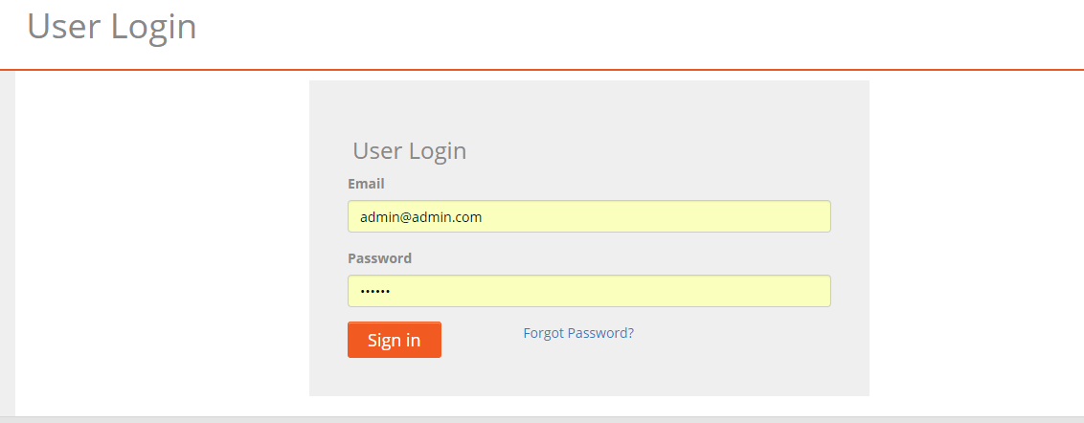
Customer Login

Slide 8
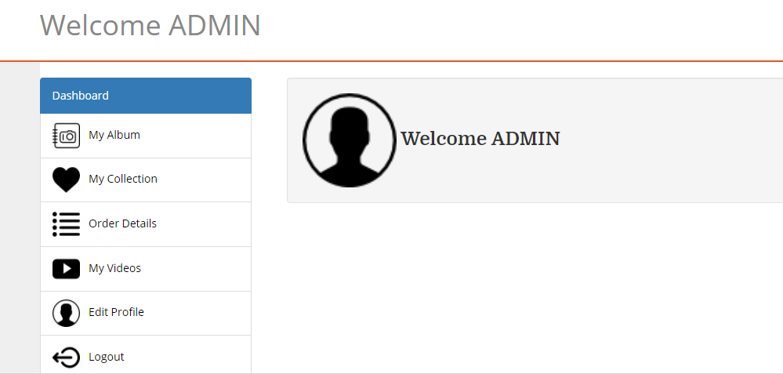
Enter Customer

Slide 9
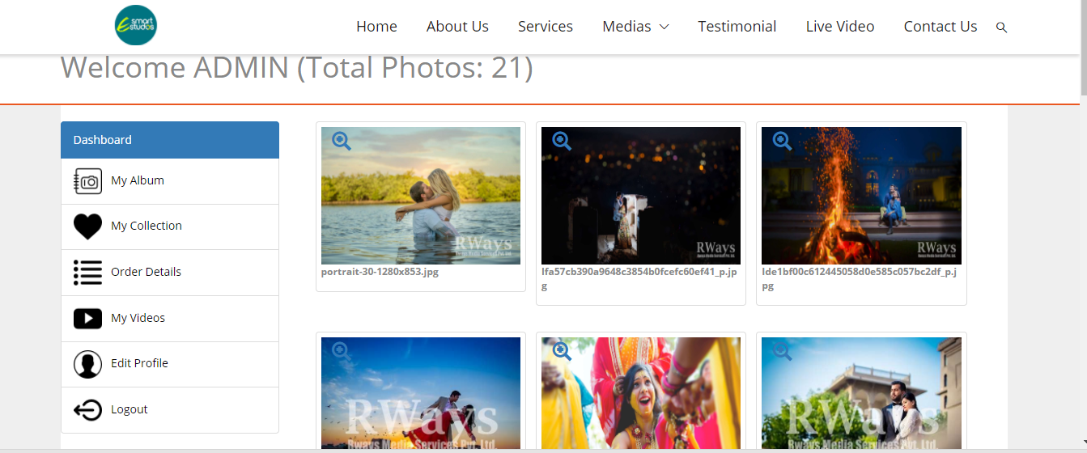
My Album Check Photo

Slide 10
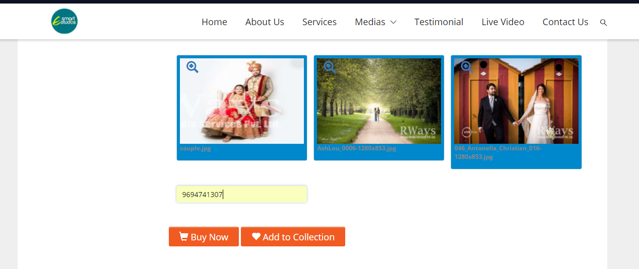
Photo Selected Customer

Slide 11
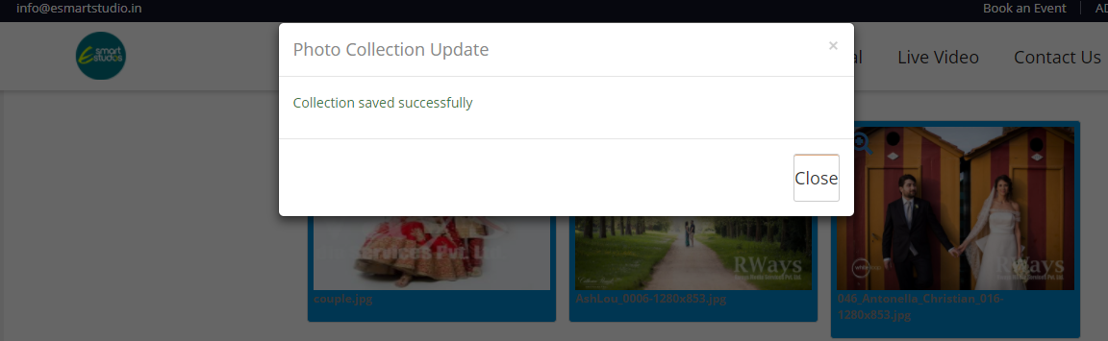

Slide 12
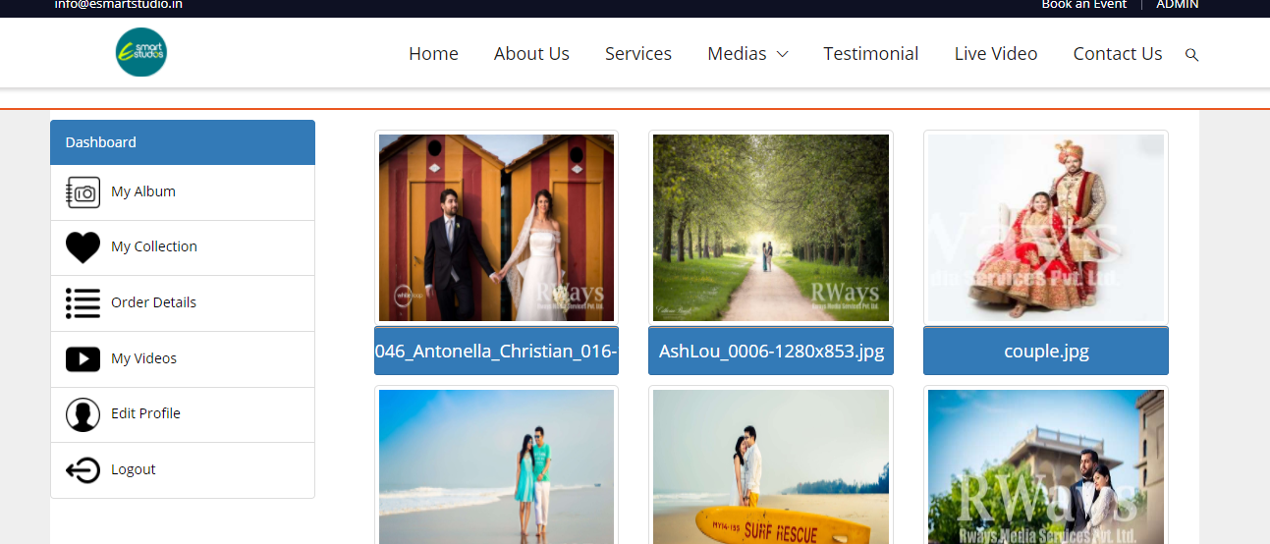
My Collection

Slide 13
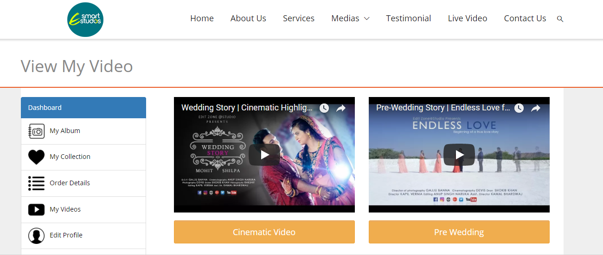

Slide 14
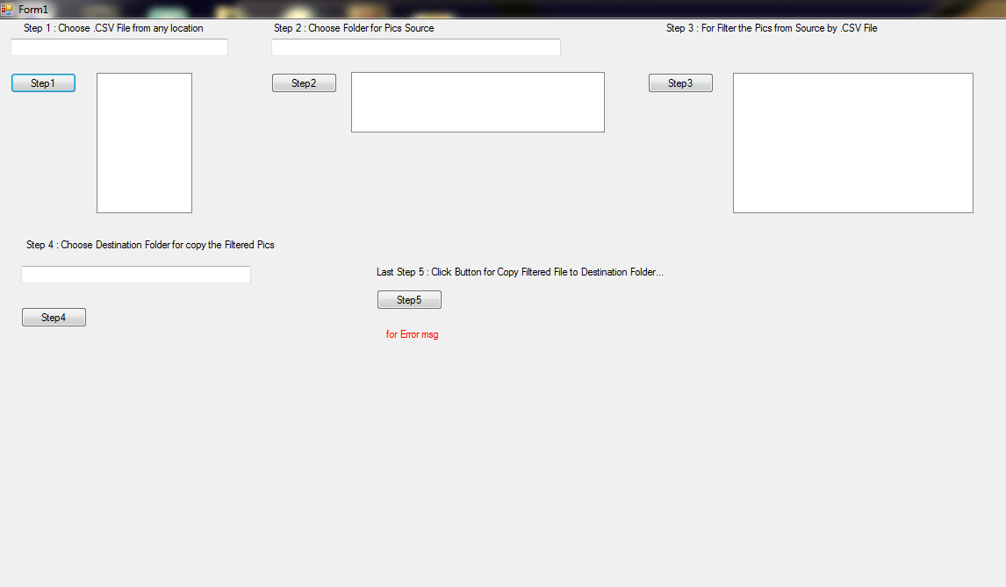
Admin Process
Get Selected Images
CSV File

Slide 15
Admin Process
Zip Selected Photos
Upload selected photos
Send to Customer

Slide 16
Benefit
Time Saving
Cost Effective
Manage your all photos online on cloud.
Another Backup Source
Increase efficiency of photographers.

Slide 17

Thank You

